Slide 1
Homelessness & Geographic Crosswalks

Slide 2
Annual Homelessness Assessment Report (AHAR) to Congress
Mandated by Congress in 2001
Began in 2007
  Reliable data in 2011
Basic Geographic Unit: Continuum of Care
Part 1: Point in Time (PIT) Counts
  Collected on a single night in late January
  Methodology varied by location
Part 2: Housing Inventory Count

Slide 3
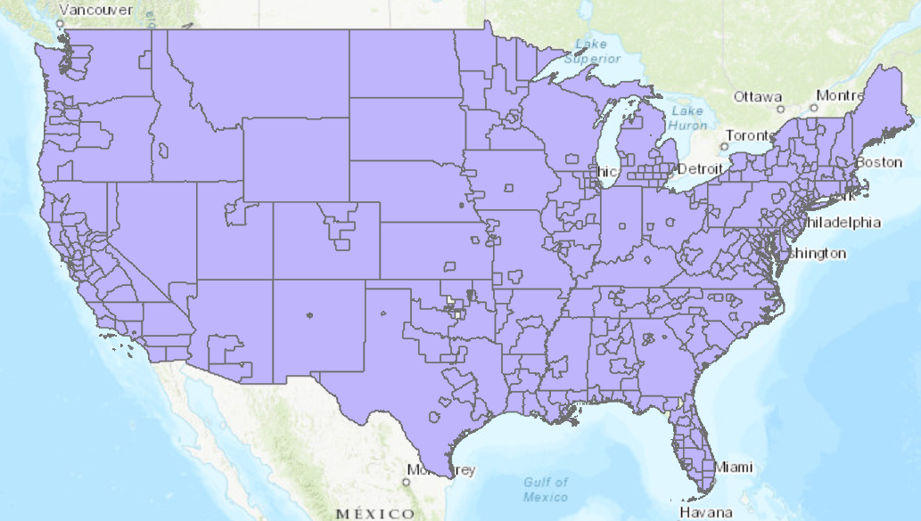
What is a CoC?
“local planning bodies responsible for coordinating the full range of homelessness services in a geographic area, which may cover a city, county, metropolitan area, or an entire state.” (AHAR Part 1, 2024)

Slide 4
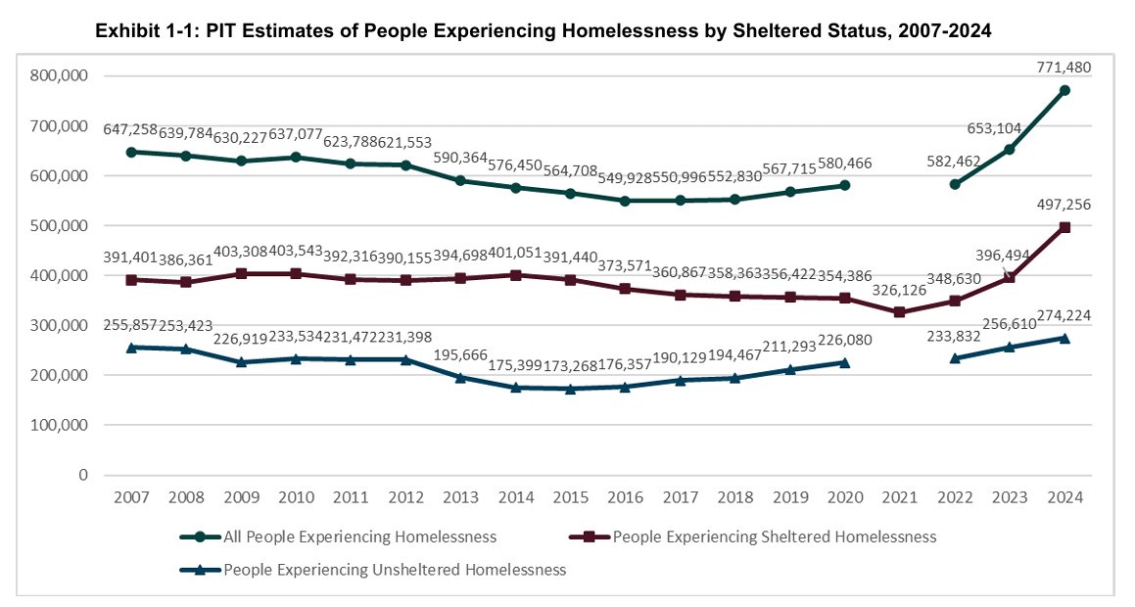
PIT Data Trends

Slide 5
Putting the Data in Context
CoCs vary wildly in size
Hard to know the exact populations
The solution: a crosswalk
  Match counties to CoCs
  Get population and other data from ACS

Slide 6
Geographic Crosswalk: How it works
Uses centroids to match census tracts (include picture of centroids?)

Slide 7
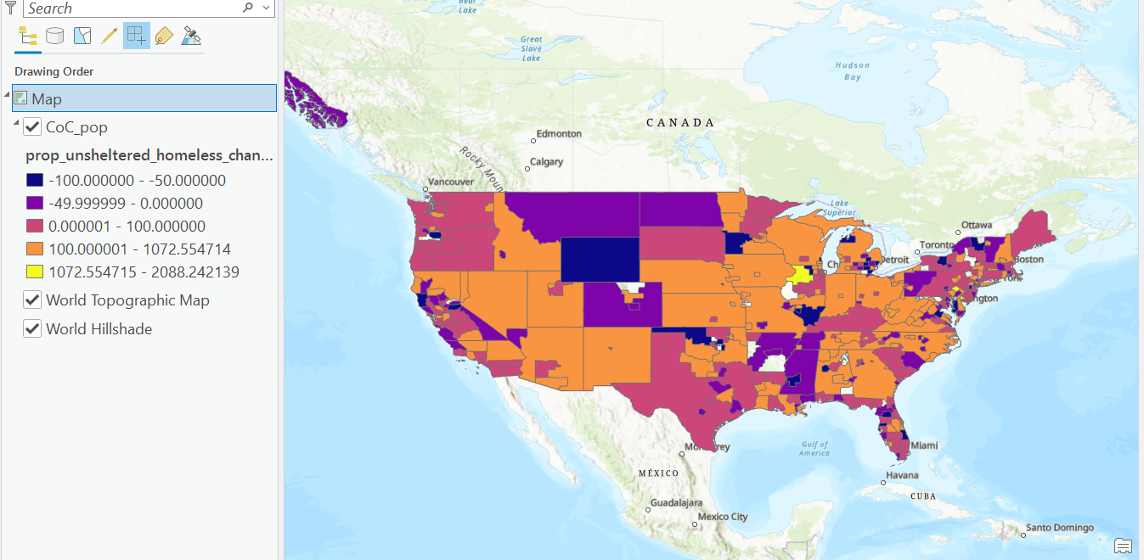
Results

